Slide 1

Working With Data DATA9910
Week 10
Lucas Rizzo
email: lucas.rizzo@tudublin.ie
Notes:
Entered text
Slide 1: Introduction
Start with a brief introduction to the topic of image processing.
Mention that it's a crucial field in today's digital age.
Explain that you'll be covering the basics, real-world applications, and key terminology.
Slide 2: What is Image Processing?
Define image processing as the manipulation of an image to extract information or enhance its features.
Mention its wide range of applications, from photography to medical imaging.
Slide 3: Importance of Image Processing
Discuss the importance of image processing in various fields:
Medical: Diagnosis and treatment planning.
Entertainment: Special effects in movies and video games.
Security: Face recognition and surveillance.
Agriculture: Crop analysis and yield prediction.
Manufacturing: Quality control and defect detection.
Emphasize how it improves decision-making, saves time, and reduces errors.
Slide 4: Real-world Applications
4.1: Medical Imaging
Explain how image processing is used in medical imaging.
Mention applications like MRI, CT scans, and X-rays.
Highlight its role in disease detection and treatment planning.
4.2: Entertainment
Discuss how image processing enhances visual effects in movies and video games.
Mention CGI (Computer-Generated Imagery) and motion capture technology.
4.3: Security
Explain image processing's role in security through face recognition and surveillance systems.
Emphasize its significance in crime prevention and national security.
4.4: Agriculture
Discuss its applications in agriculture, such as crop analysis and yield prediction.
Explain how it helps farmers make informed decisions.
4.5: Manufacturing
Describe how image processing is used in manufacturing for quality control and defect detection.
Mention its role in ensuring product consistency.

Slide 2
Indicative schedule
Week 1 | Set up environment and R notebook
Week 2 | Review Python and practice
Week 3 | Review R Importing data with R
Week 4 | Intro SQL and aggregate queries
Week 5 | Databases and scripting languages (To be submitted)
Week 6 | Interpreting Data (summary statistics, data visualisation)
Week 7 | Review week
Week 8 | Data manipulation in R Pandas and Numpy
Week 9 | Data visualisation in Python Data processing (regular expressions)
Week 10 | Audio data (R and tuneR) (To be submitted)
Week 11 | Image data (Python and skimage) (To be submitted)
Week 12 | Time series (Python and Pandas)
Week 13 | Working on Assignment Assignment deadline

Slide 3
Overview
Audio data introduction
Seewave and tuneR packages
Extracting audio properties
Noise and filters in audio
Audio visualisations

Slide 4
What is audio data?
Representation of sound in a digital format
Collection of samples of sound waves captured over time (hence, a type of time series as well)
Each sample represents the amplitude of the sound wave at a specific point in time (pressure made by the sound in a microphone)

Slide 5
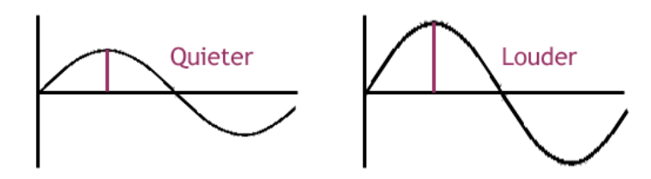
What is audio data?
Representation of sound in a digital format
Collection of samples of sound waves captured over time (hence, a type of time series as well)
Each sample represents the amplitude of the sound wave at a specific point in time (pressure made by the sound in a microphone)
dBs
dBs
Amplitude is the sound intensity measured in decibels (dB) which we perceive as loudness.
Time
Time

Slide 6
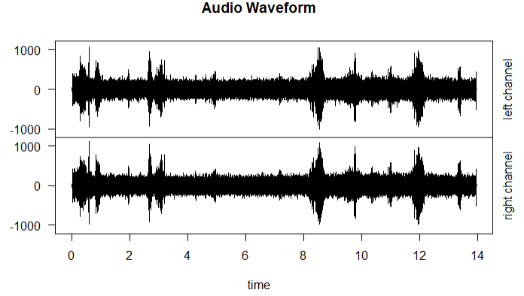

What is audio data?
In R we can use tuneR and ggplot2 to show the waveform of an audio file
library(tuneR)
audio <- readWave("Bombycilla-cedrorum-313682.wav")
plot(audio, main = "Audio Waveform")

Slide 7
Applications
Audio is a type of signal. A signal is anything that carries quantitative information that varies with time, such as temperature, pressure, or any other independent variable.
Signals pervade our everyday life, thus the study of their behavior and how we can extract information from them is extremely important.
Applications of digital signal processing, span numerous different fields, such as ecology, physics, communication, medicine, computer science, mathematics, and electrical engineering.

Slide 8
Sources of audio data
There are many repositories containing open source audio data:
DagsHub: audio datasets from a “centralized platform to host and manage machine learning projects”
Freesound: collaborative database of creative-commons licensed sounds
Audioset: large-scale dataset of manually annotated audio events
ECS-50: labeled collection of 2000 environmental audio recordings
Desed: Domestic environment sound event detections
VoxCeleb: 100,000 utterances for 1,251 celebrities, extracted from videos uploaded to YouTube

Slide 9
Reading audio data
tuneR is a comprehensive R package for working with audio data.
It provides functions for reading, manipulating, and analyzing audio files.
It provides functions to read both mp3 (lossy compression format) and wav (uncompressed audio format) files library(tuneR)
audio_wav <- readWave("Bombycilla-cedrorum-313682.wav")
audio_mp3 <- readMP3("Bombycilla-cedrorum-313682.mp3")

Slide 10
Task 1
Download the laugh.wav file here
Load it with the readWave function and plot its waveform.
Analyse the waveform, and load the file again, but only the last “hiccup”. Check the documentation of readWave to identify the parameters you can use to load only a part of the file.
Solution in the next slide...

Slide 11
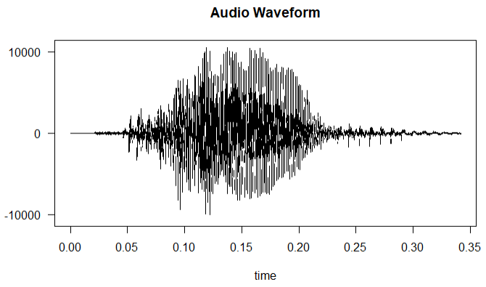
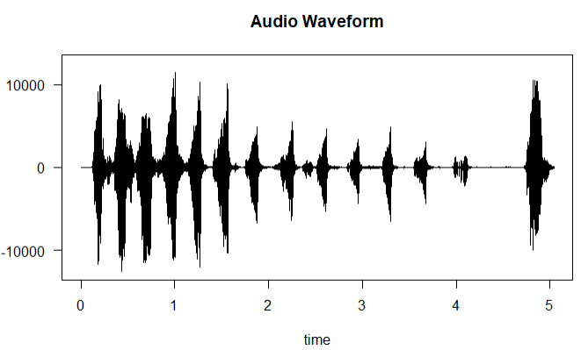
Task 1
Laugh part
audio <- readWave("laugh.wav")
plot(audio, main = "Audio Waveform")
audio <- readWave("laugh.wav", from = 4.7, to = Inf, units = "seconds")
plot(audio, main = "Audio Waveform")

Slide 12
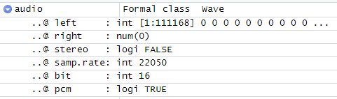
Extracting audio properties
The audio object in tuneR has several attributes that inform on essential properties

Slide 13
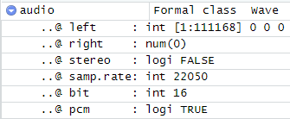
Extracting audio properties
Left, right: amplitude values for each sample in the left and right channels.
Stereo: flag to indicate two independent audio channels to create a sense of directionality and spatial depth
Samp.rate: number of samples recorded per second. Common values include 22.05 kHz (older audio formats), 44.1kHz (audio CDs), 48 kHz (DVD, blu-ray), 96 kHz (high-resolution audio recordings), 192 kHz (professional audio recording)
Bit: bit depth, number of bits used to represent each sample of audio data. 16 bits (audio CD), 24 bits (professional recordings), 32 bits (high-resolution audio formats)
PCM: If pulse-code modulation (PCM) was used to digitally represent sampled analog signals

Slide 14
Extracting audio properties
Duration can also be extracted using the duration function
> audio <- readWave("laugh.wav")
> duration_seconds <- duration(audio)
> print(duration_seconds)
[1] 5.041633
Number of frames, range of amplitude and file size can also be extracted with R functions
num_frames <- length(audio) # Measurement of the amplitude
max_amplitude <- max(audio@left) # Max amplitude of left channel
min_amplitude <- min(audio@left) # Min amplitude of left channel
file_size <- file.size("laugh.wav") # File size in bytes

Slide 15
Extracting audio properties
Root Mean Square (rms) energy can be extracted to provide an indication of the signal's intensity or loudness.
These are usually used in a comparative manner, for example, between different segments of the signal.
> rms_energy <- rms(audio@left)
> print(rms_energy)
[1] 1362.28

Slide 16
Task 2
Complete the print_audio_metadata function in the notebook and print:
If the file is stereo or not
Sample rate
Bit depth
Number of channels
Duration in seconds
Number of frames
Min and max amplitude of each channel.
Example using laugh.wav
Solution in the next slide...
> print_audio_metadata("laugh.wav")
Stereo: False
Duration: 5.041633 seconds
Sample Rate: 22050 Hz
Bit Depth: 16 bits
Number of Channels: 1
Number of Frames (Left): 111168
Min Amplitude (Left Channel): -12556
Max Amplitude (Left Channel): 11430

Slide 17
Task 2
print(paste0("Duration: ", duration(audio), " seconds"))
print(paste0("Sample Rate: ", sample_rate, "Hz\n"))
print(paste0("Bit Depth: ", bit_depth, "bits\n"))
print(paste0("Number of Channels: ", num_channels))
if (length(audio@left) > 0) {
print(paste0("Number of Frames (Left): ", length(audio@left)))
print(paste0("Min Amplitude (Left Channel): ", min(audio@left)))
print(paste0("Max Amplitude (Left Channel): ", max(audio@left)))
}
if (length(audio@right) > 0) {
print(paste0("Number of Frames (Right): ", audio@right))
print(paste0("Min Amplitude (Right Channel): ", min(audio@right)))
print(paste0("Max Amplitude (Right Channel): ", max(audio@right)))
}

Slide 18
Noise and Filters
Using filters to remove noise and obtain only the desired portions of signals (audio) is a huge part of signal processing.
Filtering audio data is important for both noise reduction and signal enhancement. For example:
Background noise reduction
Filtering audio frequencies for transmission efficiency and to comply with system constraints.
Speech and audio recognition by extracting relevant features from the audio signal

Slide 19
Frequency
Understanding audio frequency is important when filtering and separating audio signals.

Slide 20
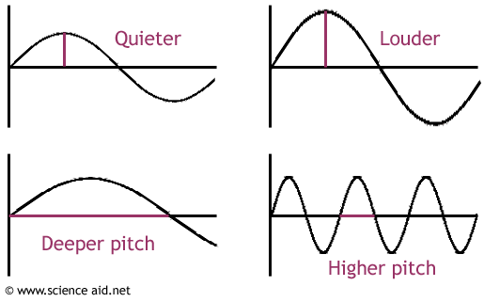
Frequency
Understanding audio frequency is important when filtering and separating audio signals.
dBs
Amplitude is the sound intensity measured in decibels (dB) which we perceive as loudness.
dBs
Frequency, measured in Hertz (Hz), indicates how many sound vibrations happen per second. People interpret frequency as low or high pitch.
Time
Time

Slide 21
Frequency
Understanding audio frequency is important when filtering and separating audio signals.
The human hearing range lies between 20 and 20,000 Hz.
Most people perceive as low pitch all sounds below 500 Hz — like the plane engine roar. In turn, high pitch for is everything beyond 2,000 Hz (for example, a whistle.)

Slide 22
Noise and Filters
In R, the signal package provides various filter design and implementation functions
We can see an example using a simulated signal.

Slide 23
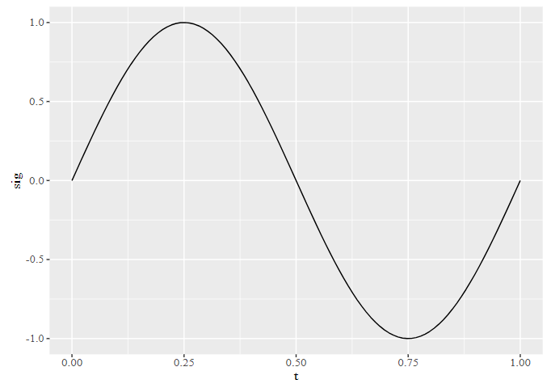
Noise and Filters
In R, the signal package provides various filter design and implementation functions
We can see an example using a simulated signal.
library(signal)
t <- seq(0, 1, len = 100)
sig <- sin(2 * pi * t)
ggplot(mapping = aes(t, sig)) +
geom_line()

Slide 24
Noise and Filters
In R, the signal package provides various filter design and implementation functions
We can see an example using a simulated signal.
“Perfect” signal using the sinusoide
library(signal)
t <- seq(0, 1, len = 100)
sig <- sin(2 * pi * t)
ggplot(mapping = aes(t, sig)) +
geom_line()

Slide 25
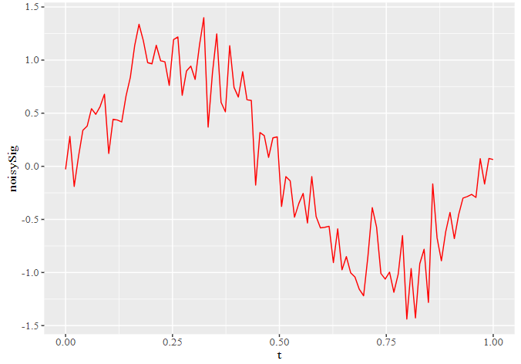
Noise and Filters
We can then add some noise to the previous signal
Using the signal package we will try to extract the original sinusoidal signal
noisySig <- sin(2 * pi * t) + 0.25 * rnorm(length(t))
ggplot() +
geom_line(aes(t, noisySig), color = "red")

Slide 26
Noise and Filters
We can then add some noise to the previous signal
Using the signal package we will try to extract the original sinusoidal signal
noisySig <- sin(2 * pi * t) + 0.25 * rnorm(length(t))
ggplot() +
geom_line(aes(t, noisySig), color = "red")
Function is used to generate random numbers from a normal distribution.

Slide 27
Signal filters
signal provides a variety of functions for designing and applying digital filters.
These filters act like cleaners for audio, selectively allowing or reducing certain frequencies.
The choice depends on the specific cleaning needs, with trade-offs between simplicity and effectiveness.
Each filter has its own way of cleaning, and the best one depends on the unique characteristics of the audio and the goals of the cleaning process.

Slide 28
Signal filters
Some examples include:
fir1: designs a filter that cleans up the audio by letting through only certain frequencies and reducing the others
butter: a smoother filter that cleans up audio by letting through frequencies up to a certain point and gradually reducing the others
cheby1, cheby2: reduces some frequencies while allowing others through
ellip: reduces unwanted frequencies while allowing through the ones you want
For a more comprehensive explanation on how they work, check here.

Slide 29

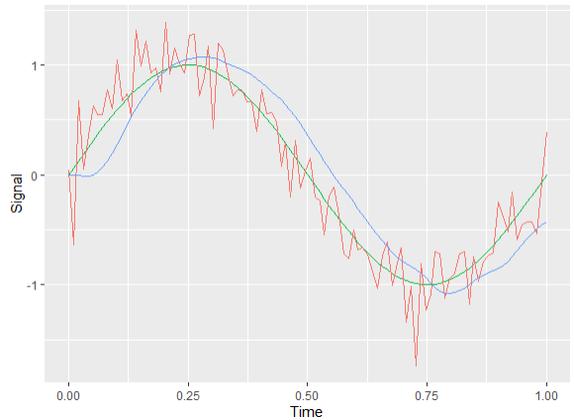
Noise and Filters
Using the butter filter we will try to recover the original signal
butterFilter <- butter(3, 0.1)
recoveredSig <- filter(butterFilter, noisySig)
allSignals <- data.frame(t,
Sig,
noisySig,
recoveredSig)
ggplot(allSignals, aes(t)) +
geom_line(aes(y = sig,
color = "Original")) +
geom_line(aes(y = noisySig,
color = "Noisy")) +
geom_line(aes(y = recoveredSig,
color = "Recovered")) +
labs(x = "Time", y = "Signal")

Slide 30
Noise and Filters
Using the butter filter we will try to recover the original signal
We need to understand these
butterFilter <- butter(3, 0.1)
recoveredSig <- filter(butterFilter, noisySig)
allSignals <- data.frame(t,
Sig,
noisySig,
recoveredSig)
ggplot(allSignals, aes(t)) +
geom_line(aes(y = sig,
color = "Original")) +
geom_line(aes(y = noisySig,
color = "Noisy")) +
geom_line(aes(y = recoveredSig,
color = "Recovered")) +
labs(x = "Time", y = "Signal")

Slide 31
Butterworth filter
butter(n,
W,
type = c("low", "high", "stop", "pass"),
plane = c("z", "s"), …)
n: filter order, how quickly the filter responds to changes in frequency. Higher values generally result in a quicker decrease of the amplitude
W: critical frequencies of the filter type
type: low (default) / high, allows low-frequency components; stop/pass: allows a specific range or band of frequencies to pass/stop
plane: z (default) digital signals, s analog signals

Slide 32
Task 3
Some experimentation is usually necessary when applying filters. Play with the butter n and W filter values. Compare different results and see if you can better approximate the filtered signal to the original one.
Solution in the next slide...

Slide 33
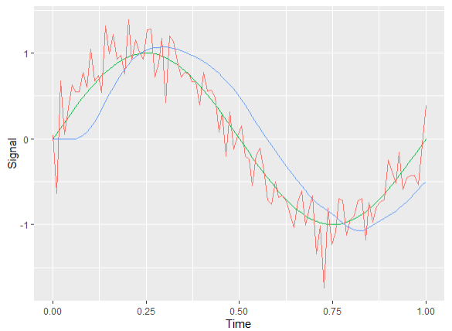
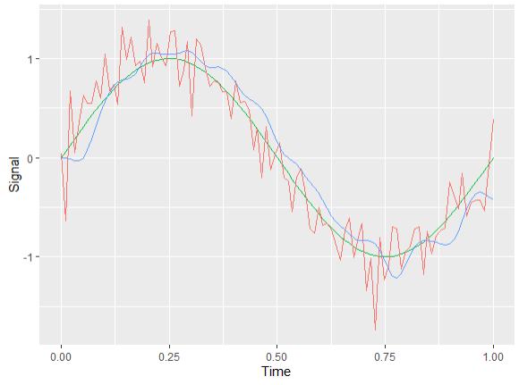
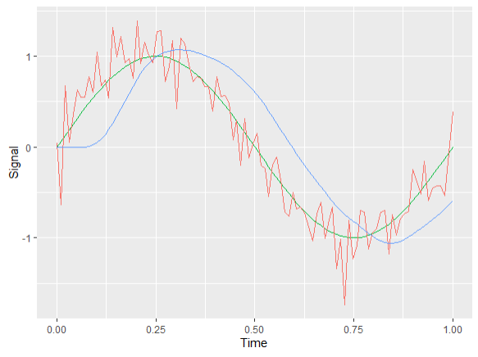
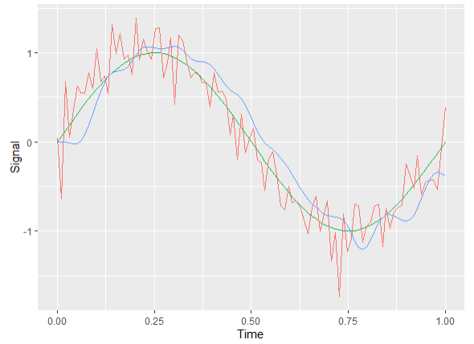
Task 3
n = 4
w = 0.1
n = 4
w = 0.2
n = 5
w = 0.1
n = 5
w = 0.2

Slide 34
Fourier Transforms and Spectrograms
When working with signals both time domain and the frequency domain can provide valuable information about a signal.
In physics, engineering and mathematics, the Fourier transform (FT) is a type of transformation that maps a function from its original function space into another function space via integration.
The Discrete Fourier Transform (DFT) is a specific form of the Fourier Transform that allows switching from the time domain to the frequency domain to build the frequency spectrum of the original time wave.
For a visual explanation of Fourier Transform check here.

Slide 35
Fourier Transforms and Spectrograms
A Short-Time Fourier Transform (STFT), is computed when a window is “slided” along the signal and a DFT is computed at each of these slides
This way we represent the signals in the frequency spectrum, while also maintaining most of the information from the time dimension.
The results for a STFT are usually plotted in a spectrogram.

Slide 36
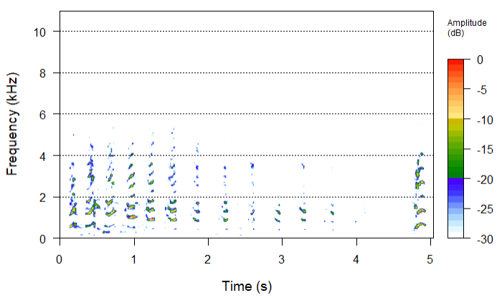
Fourier Transforms and Spectrograms
The seewave package provides the spectro function
library(seewave)
audio <- readWave("laugh.wav")
spectro(audio)

Slide 37
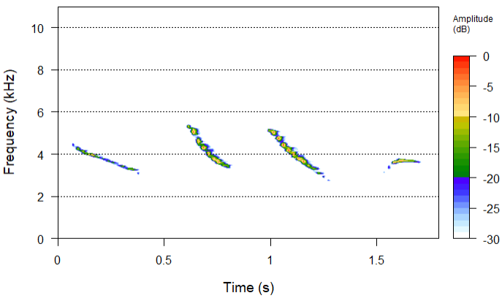
Fourier Transforms and Spectrograms
The seewave package provides the spectro function
library(seewave)
audio <- readWave("tico.wav")
spectro(audio)

Slide 38
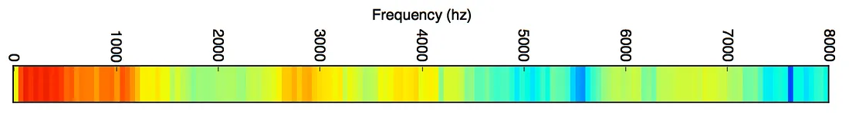
Spectrograms example applications
20 millisecond sound snippet with a lot of low-frequency energy and not much energy in the higher frequencies. That’s typical of “male” voices.

Slide 39
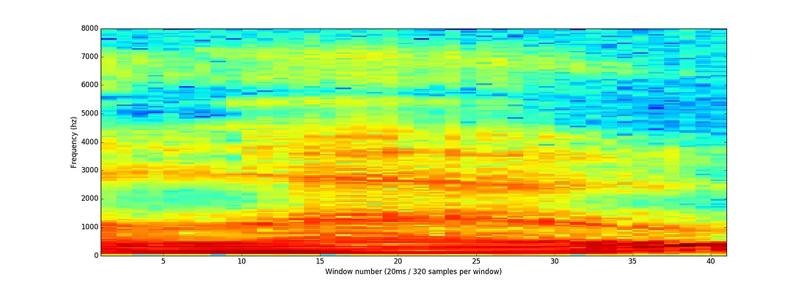
Spectrograms example applications
The full spectrogram of the “hello” word

Slide 40
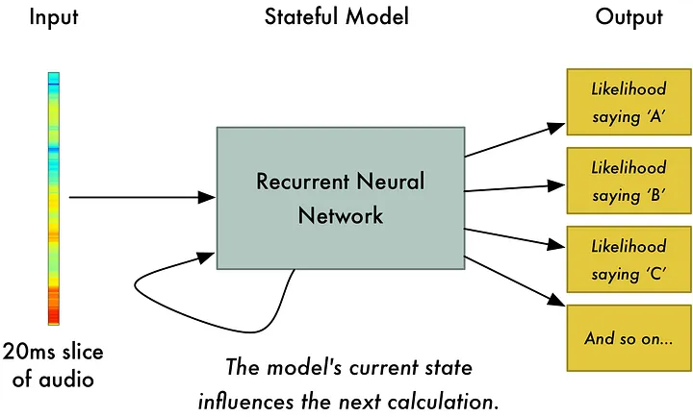
Spectrograms example applications
Slice of spectrogram fed into a deep neural network. For each little audio slice, it will try to figure out the letter that corresponds the sound currently being spoken.

Slide 41
Spectro Function
The spectro function also has a long list of parameters that allows us to control how the spectrogram is created.
Let’s see how some of them work…
Usage
spectro(wave, f, channel = 1, wl = 512, wn = "hanning", zp = 0,
ovlp = 0, noisereduction = NULL, fastdisp = FALSE,
complex = FALSE, norm = TRUE, correction="none",
fftw = FALSE, dB = "max0", dBref = NULL, plot = TRUE,
flog = FALSE, grid = TRUE, osc = FALSE, scale = TRUE, cont = FALSE,
collevels = NULL, palette = spectro.colors,
contlevels = NULL, colcont = "black",
colbg = "white", colgrid = "black",
colaxis = "black", collab="black",
cexlab = 1, cexaxis = 1,
tlab = "Time (s)",
flab = "Frequency (kHz)",
alab = "Amplitude",
scalelab = "Amplitude\n(dB)",
main = NULL,
scalefontlab = 1, scalecexlab =0.75,
axisX = TRUE, axisY = TRUE, tlim = NULL, trel = TRUE,
flim = NULL, flimd = NULL,
widths = c(6,1), heights = c(3,1),
oma = rep(0,4),
listen=FALSE,
...)

Slide 42
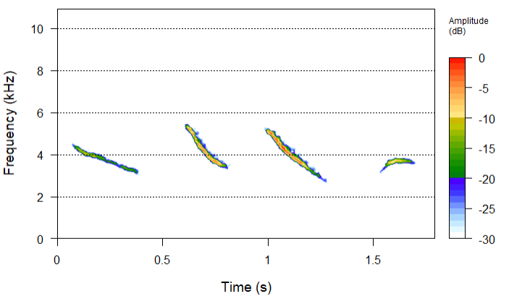
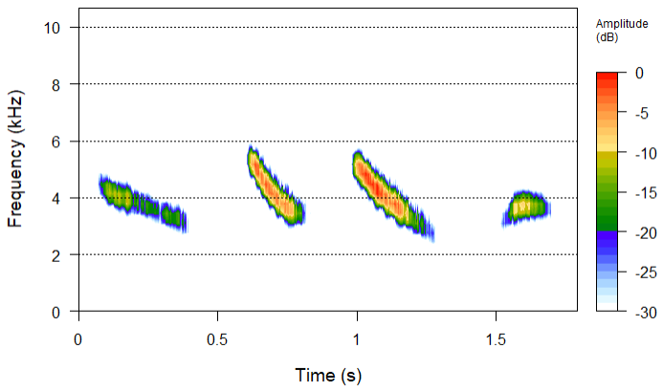
Spectro Function
spectro(tico, wl=5096) Longer window lengths provide better frequency resolution.
spectro(tico, wl=64) Shorter window lengths provide better time resolution.

Slide 43
Spectro Function
Clearer identification of distinct frequencies. Poorer time resolution, meaning quick changes in frequency are harder to detect.
spectro(tico, wl=256) Longer window lengths provide better frequency resolution.
spectro(tico, wl=64) Shorter window lengths provide better time resolution.

Slide 44
Spectro Function
spectro(tico, wl=256) Longer window lengths provide better frequency resolution.
Better for detecting rapid changes in the signal. Less accurate frequency representation.
spectro(tico, wl=64) Shorter window lengths provide better time resolution.

Slide 45
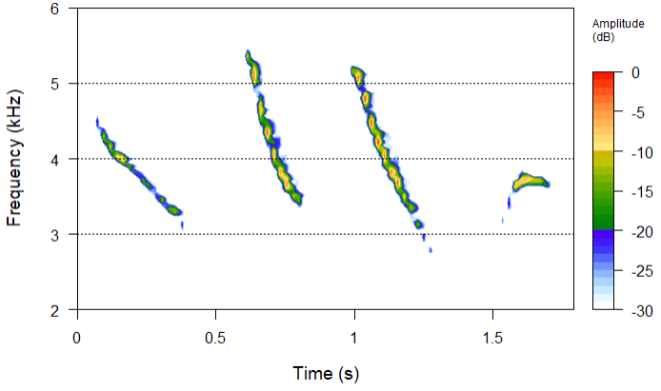
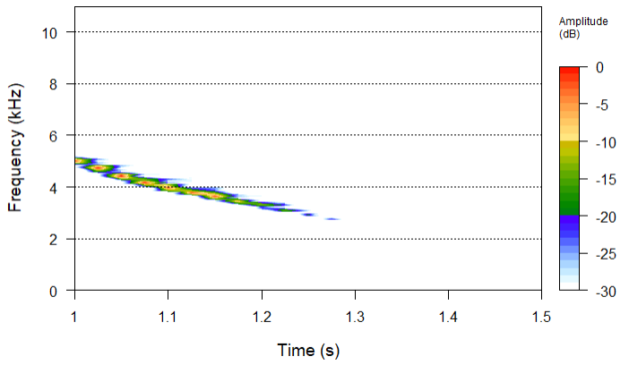
Spectro Function
spectro(tico,flim=c(2,6)) flim specifies the range of frequencies to focus (like a zoom)
spectro(tico, tlim=c(0.5,1.5)) tlim specifies the time windows to analyse

Slide 46
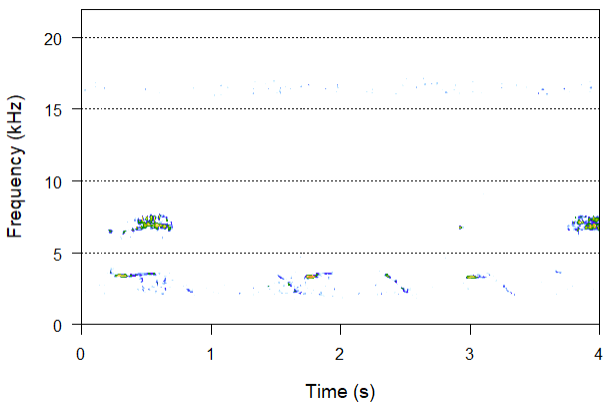
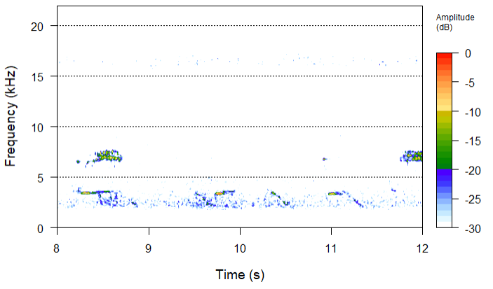
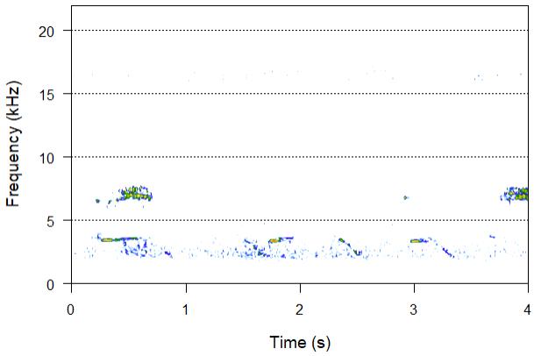
Spectro Function
spectro(audio, noisereduction = 1)
nosiereduction can be applied along the rows (frequency) with value 1 or columns (time) with value 2
Noisy example
spectro(audio, noisereduction = 2)

Slide 47
Spectro Function
spectro(audio, noisereduction = 1)
nosiereduction can be applied along the rows (frequency) with value 1 or columns (time) with value 2
It is an image filter, not a signal filter. The principle consists in subtracting each spectrogram row or column by its median
Noisy example
spectro(audio, noisereduction = 2)

Slide 48

Spectro Function
The spectro function can also return the time, frequency, and amplitude values of the decompositions
audio <- readWave("laugh.wav")
fft_data = spectro(audio)

Slide 49
Spectro Function
The spectro function can also return the time, frequency, and amplitude values of the FFT decompositions
audio <- readWave("laugh.wav")
fft_data = spectro(audio)
Number of columns

Slide 50
Spectro Function
The spectro function can also return the time, frequency, and amplitude values of the FFT decompositions
audio <- readWave("laugh.wav")
fft_data = spectro(audio)
Number of rows

Slide 51
Spectro Function
The spectro function can also return the time, frequency, and amplitude values of the FFT decompositions
audio <- readWave("laugh.wav")
fft_data = spectro(audio)
Amplitude value for each column and row

Slide 52
Task 4
Download the bird song here. It should sound like that
Plot its spectrogram using spectro.
Using the previous parameters, try to provide a clearer representation of the bird sounds.
Example solution in the next slide...

Slide 53
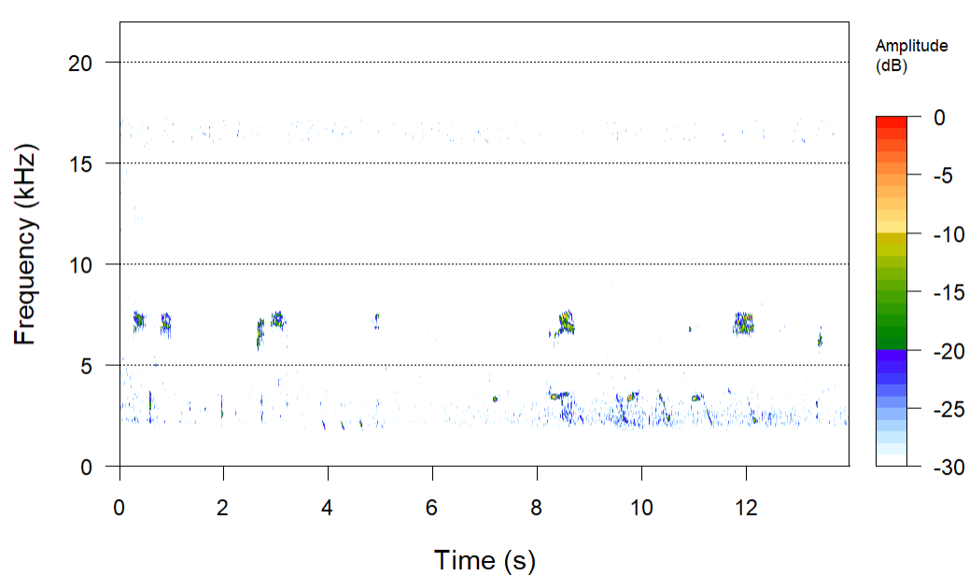
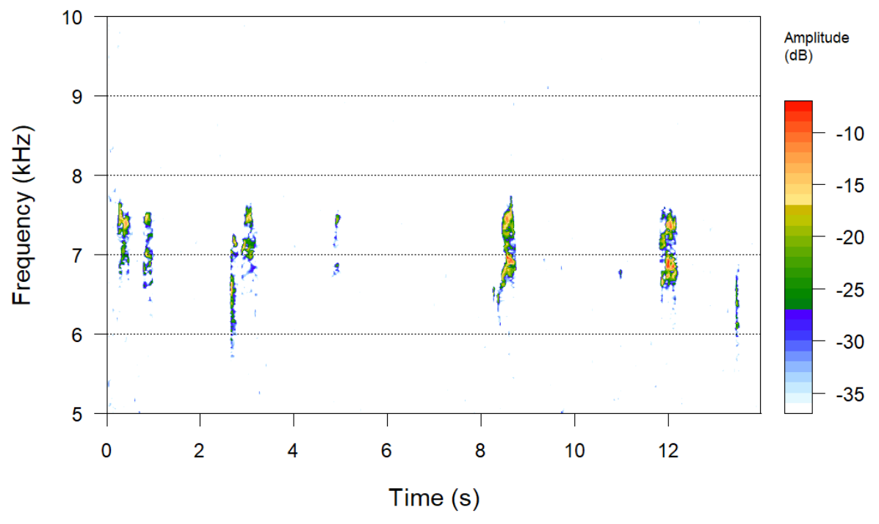
Task 4
spectro(audio, flim=c(5, 10), wl=2048, noisereduction = 1)
Original

Slide 54
Python
Python is also great for digital signal processing.
Datacamp has a spoken language processing in Python course which also introduces audio data.
Digital Signal Processing in Python, free O’Reilly book.
Common packages include Librosa, TensorFlow Signal Processing, scipy.signal, etc.

Slide 55
Summary
Audio data definition
Sources of audio data
Reading audio files
Extracting some audio properties
Noise and filters
Spectrograms

Slide 56
References
R Programming for Data Sciences (Chapter 14), Jeffrey W. Doser
Cran quick tutorial for signal processing in R
Fourier Transform visually explained (Youtube)
R in Digital Signal Processing (Rpubs quick tutorial)
Speech recognition with deep learning (Medium)

Slide 57
Lab
Please work on the assignment in week 10 folder. This will need to be submitted by Week 11.

Slide 58
Questions?

